Slide 1
AHC workshop on Researcher Positionality
Nina Wardleworth
n.a.wardleworth@leeds.ac.uk

Slide 2
Positionality and Inclusive Citation
Myth of academic neutrality.
Who is judged to be neutral?

Slide 3
Definition
Positionality refers to the stance or positioning of the researcher in relation to the social and political context of the study—the community, the organization or the participant group. The position adopted by a researcher affects every phase of the research process, from the way the question or problem is initially constructed, designed and conducted to how others are invited to participate, the ways in which knowledge is constructed and acted on and, finally, the ways in which outcomes are disseminated and published.
From Sage Encyclopaedia of Action Research

Slide 4
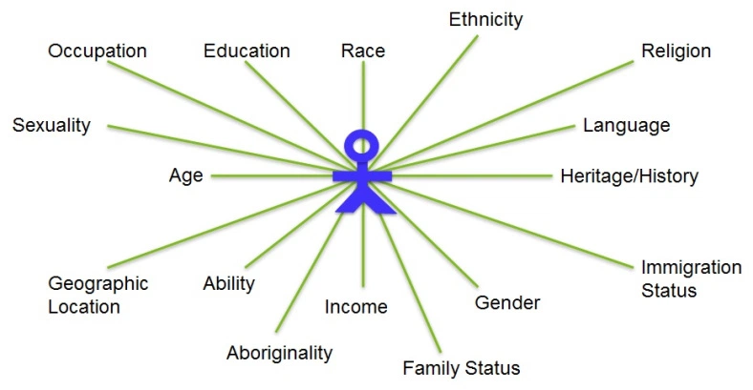
Author’s (YOUR) positionality
https://weingartenlrc.wordpress.com/2017/01/09/research-writing-whats-your-positionality/

Slide 5
Positionality Statements
State your own positionality
Place reflexive comments in your:
Acknowledgements
Introduction
Methodology
Main body
Conclusion

Slide 6
Positionality in practice – Preface of Venus noire by Robin Mitchell (ebook in library)
“It might be difficult for the non historian to understand seeing in the flesh what you have studied for a long time in pictures or books. Did I wish to see it? Yes. I don’t know if I answered out loud or if I said anything else. The body cast had not been displayed for a very long time, and access to it was restricted…The cast was brought out in an immense crate. As I waited and watched the screws holding the cover in place being removed with a power drill, my sense of anticipation began to rise. I started pacing. I am a historian, I told myself; this reaction is unprofessional. As the unpacking continued, the feelings worsened. I was having trouble breathing… As a historian, I can read the documents and interpret the silences. As an African American woman involved in cultural work about black women’s bodies, the personal is political.”

Slide 7
Discussion qs
What are your reflections on the practise of positionality, as raised by the definition and by Mitchell’s preface?
Have you seen any positionality statements in the academic writing that you have read?
How might you write a positionality statement in your academic writing? What challenges might you face?

